Slide 1
AP0400 Practical skills in Forensic Science Microscopy Dr Kate Randall Lecturer in Forensic Science

Slide 2
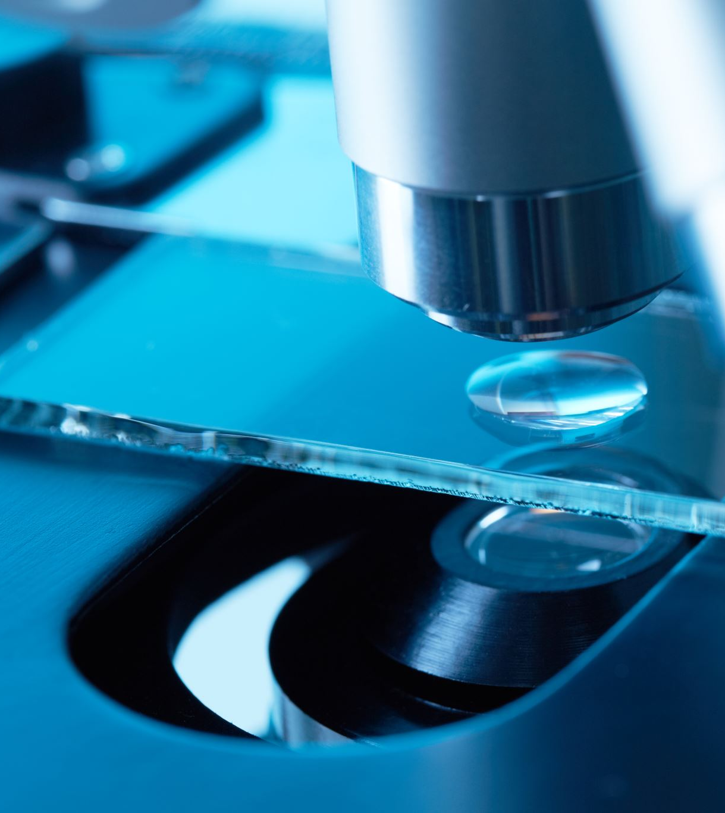
Learning objectives
1. Understand key components & basic set up of Microscopes
2. Understand the application of microscopy to Forensic Science
3. Develop awareness of different types of Microscopy
e.g.,
Comparison
Fluorescence
Polarising

Slide 3
Lecture overview
History of Microscopes
How light behaves
Key components of Microscopes & their uses
Basic set-up of Microscopes
Compound (2 or more lenses)
Other types of Microscopy
Comparison, Fluorescence & Polarising

Slide 4
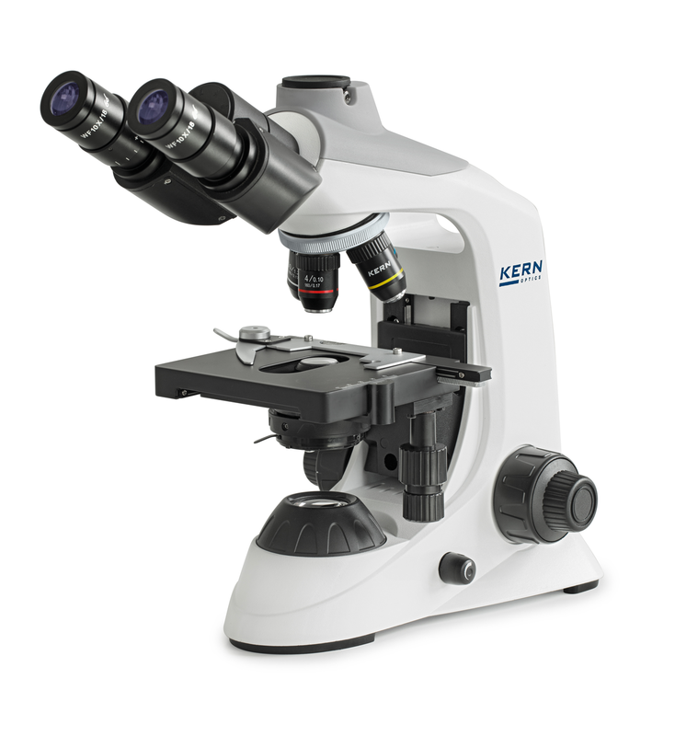
What is a microscope?
An optical instrument that uses a lens or a combination of lens to magnify & resolve the fine detail of an object
Key components:
Light
2) Magnification
Notes:
We need to be able to see the fine detail!
Samples in FS are very small.
Headache if not correct.
Compound microscope = 2 or more lens.
Resolution 0.25um (1000um = 1mm)

Slide 5
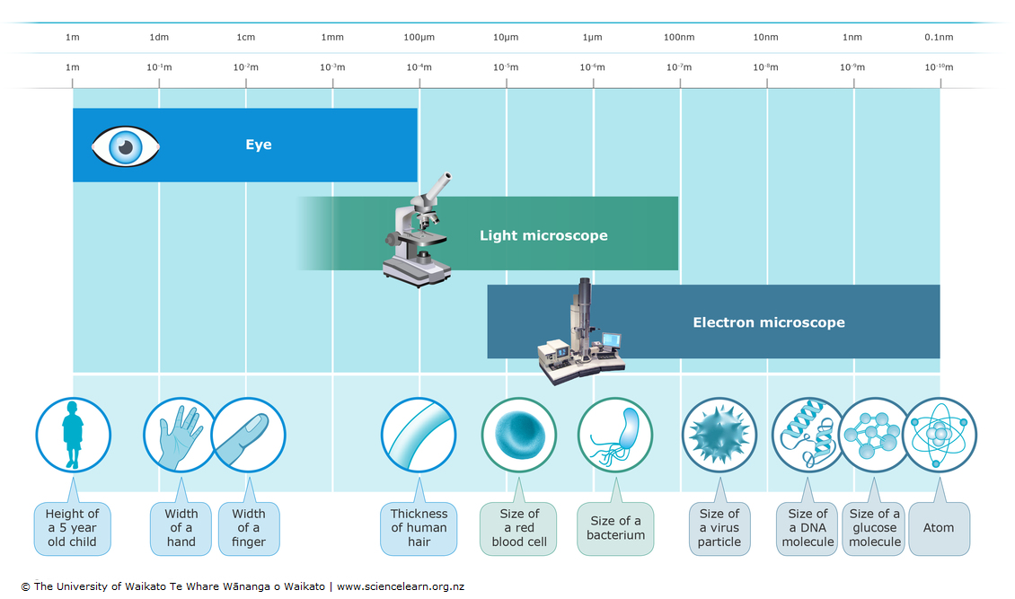
Why do we need microscopes?

Slide 6
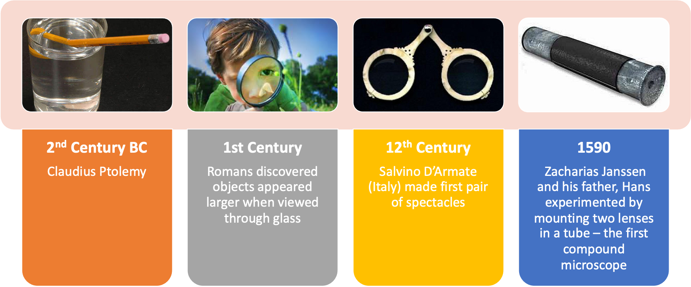
History of the microscope
3-9x magnification
Notes:
Claudius Ptolemy described a stick appearing to bend in a pool of water, and accurately recorded the angles to within half a degree. He then very accurately calculated the refraction constant of water.
Romans were looking through the glass and testing it. They experimented with different shapes of clear glass and one of their samples was thick in the middle and thin on the edges. They discovered that if you held one of these "lenses" over an object, the object would look larger.
Janssen – spectacle maker in Holland. Compound microscope – 2 or more lenses. Before this was developed the smallest object that could be viewed was the width of a human hair. Janssen’s microscope allowed for up to 3-9x magnification of the objects original size
Now efforts shifted to improve resolution – the ability to view 2 objects as separate entities, as opposed to the objects being smudged together. Best light microscope today has a resolution of 0.25um, which means objects can be as close a quarter of a um away from each other and still see them separately (1,000um = 1 mm)

Slide 7
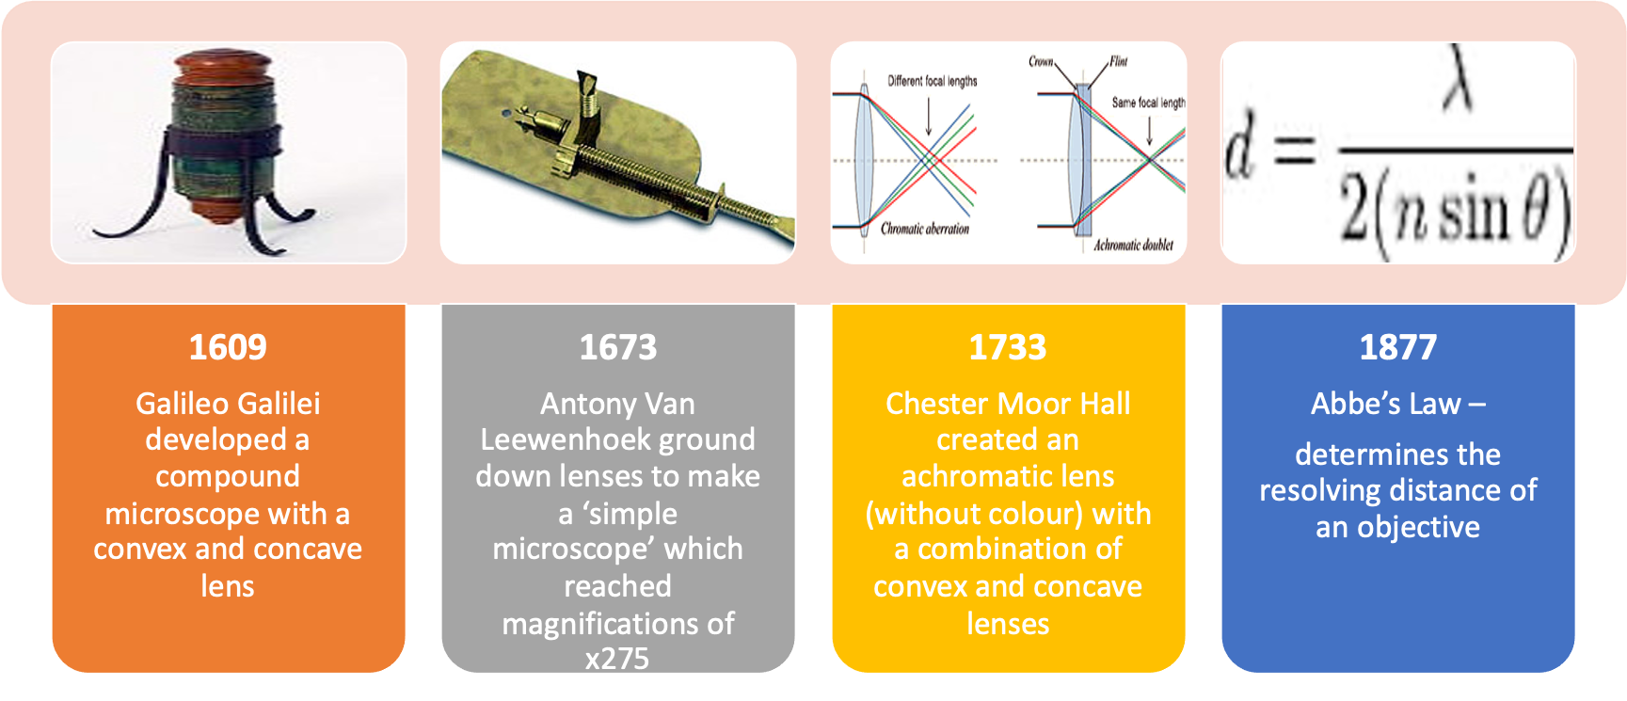
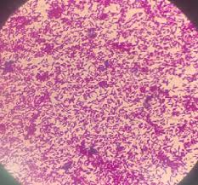
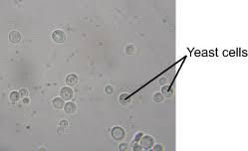
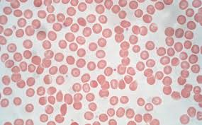
Resolution refinement
Improvements in resolution of the microscope
Current resolution down to 0.25µm
Notes:
Leewwnhoek: Leeuwenhoek's microscope used a single convex glass lens attached to a metal holder and was focused using screws. First time could view an visualise an individual cell. Took many prototypes. Able to magnify 200x. Led to discovery of bacteria, yeast, blood cells and much more.
Hall: observed that flint glass (newly made glass) dispersed colours much more than ‘crown glass’ (older glass). He designed a system that used concave lens next to a convex lens which could realign all the colours. This was the first achromatic lens. John Dolland patented the idea 20 years later, when the secret was divulged. i.e. he was able to realign colours caused by unequal bending using a second lens of a different shape.
Abbe’s Law: “minimum resolving distance (d) is related to the wavelength of light (lambda) divided by the Numeric Aperture, which is proportional to the angle of the light cone (theta) formed by a point on the object, to the objective”.

Slide 8
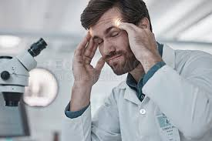
Microscopy is a key tool for Forensic Scientists
Its important you know how to a microscope
You need to know how to set them up to get the best out of it for you & the object!
Evidence search & recovery
AP0401 next semester

Slide 9
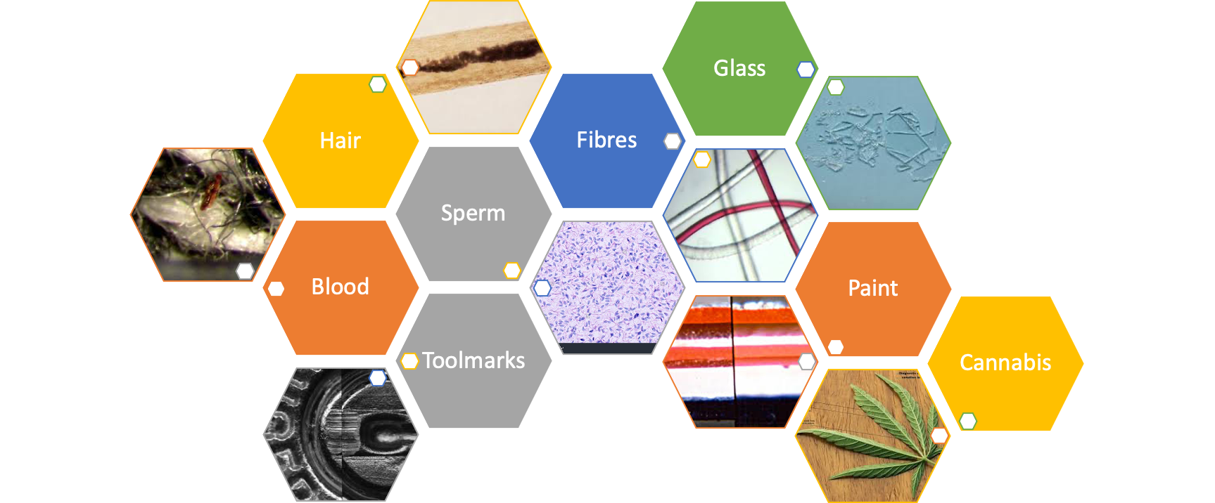
Use of microscopes in Forensic Science?

Slide 10
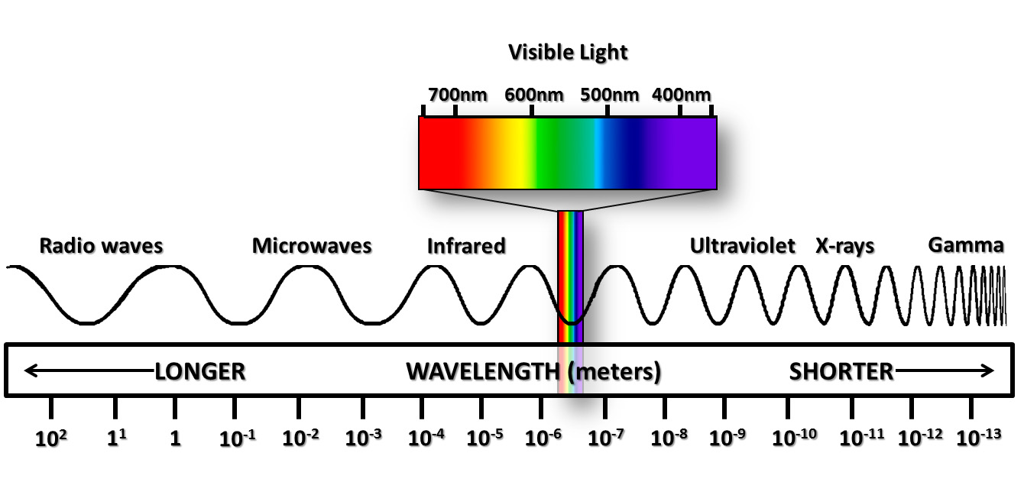
What is microscopy?
Takes advantage of energy in the form of electromagnetic radiation
Microscopy uses visible light energy interreacting with an objects surface to visualize the object
Electromagnetic radiation is in the form of waves
Waves have a length & frequency
We see certain wavelengths as different colours
Electromagnetic spectrum
Notes:
What are we thinking about when we talk about microscopy?
We are talking about light and the interaction of light with the substance surface of an object
Light is a type of energy. It is a form of electromagnetic radiation of a wavelength which can be detected by the human eye. It is a small part of the electromagnetic spectrum
Light is electromagnetic radiation that is in the form of a wave. Each wave has a wavelength or frequency. The human eye sees each wavelength as a different colour.
Wavelengths below the frequency of red are called infrared, and higher than of violet are called ultraviolet.

Slide 11
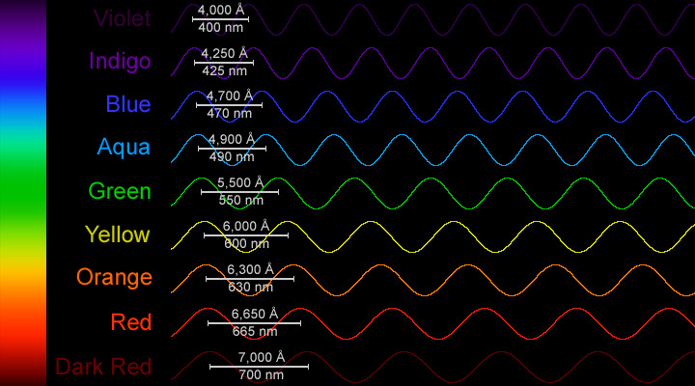
Notes:
Violet (UV end) = high frequency and therefore energy
Red (IR end) = low frequency and energy

Slide 12

Wavelength (λ), Frequency (f), Energy
Blue Light, 488 nm
short wavelength
high frequency
high energy (2 times the red)
Red light, 650 nm
long wavelength
low frequency
low energy
Visible light is a combination of the visible light waves
When these waves hit an object of interest, the waves interact with its surface
in a number of ways…
Notes:
When the light which is a combination of all of those waves we saw hits something such as our object of interest, it can interact with that surface in a number of ways

Slide 13
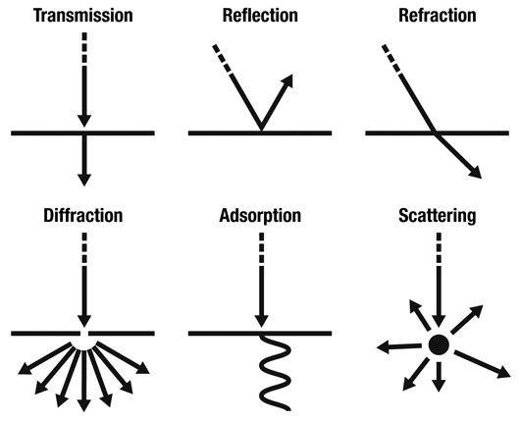
Interactions of light with a surface
Refractive Index
Is a measure of how much light is bent as it passes through a material
Angle of incidence vs. angle of refraction
Angle of
incidence
Angle of
refraction
Absorption
Notes:
It can be transmitted e.g., clear glass

Slide 14
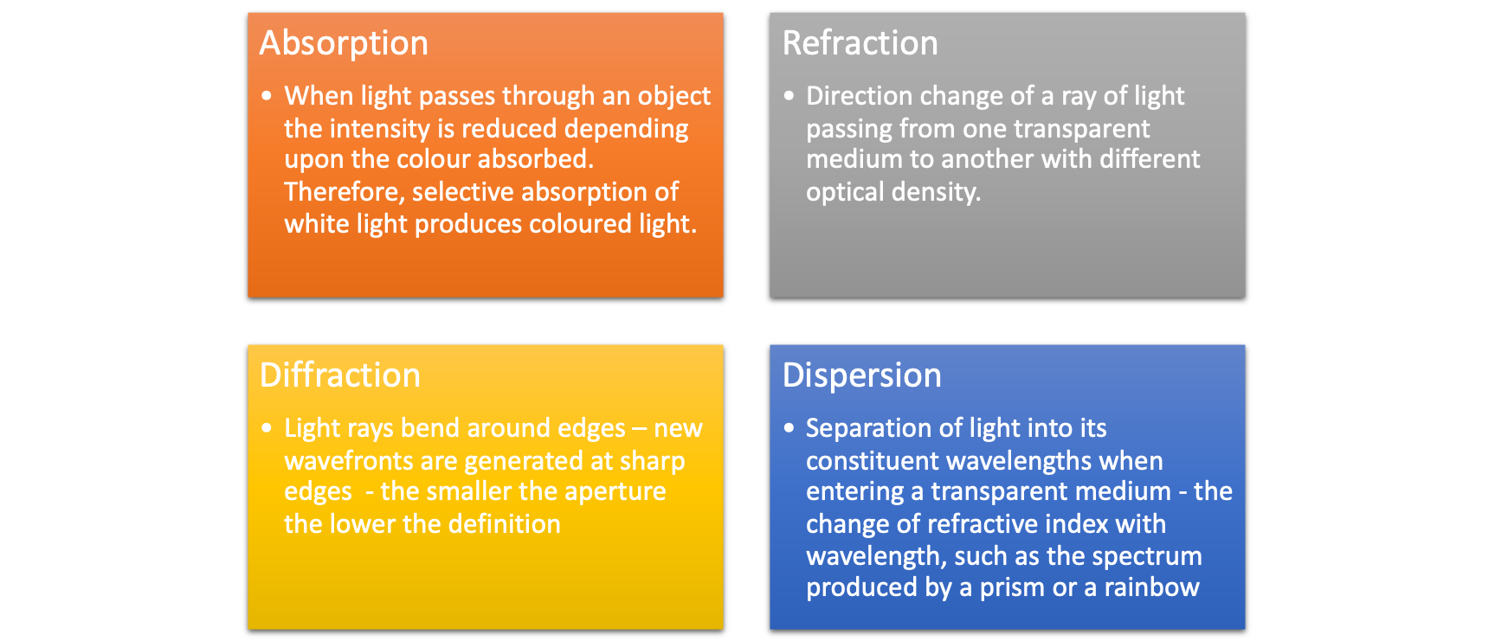
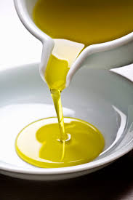
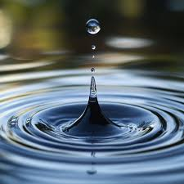
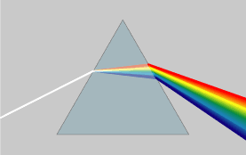
Interactions of light with a surface for microscopy
Absorption

Slide 15
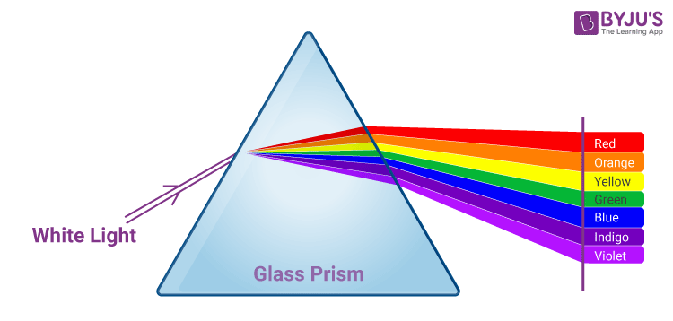
Absorption, Refraction & Dispersion
Refraction
Short wavelengths are “bent” more than long wavelengths
Absorption
Light source
Dispersion
How does this relate to what colours we see?

Slide 16
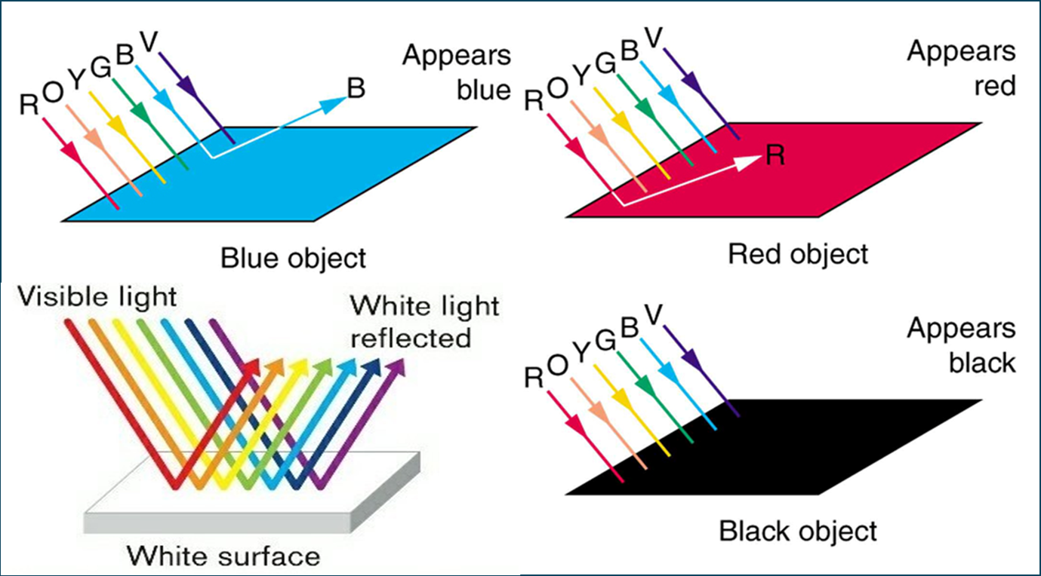
How do we see colour
Light absorption is
influenced by an
objects surface
The colour we see =
wavelength/s of light
absorbed vs. reflected
Those reflected are the
colours we see
Notes:
It is actually the wavelengths of light that are being reflected that will dictate the colour that is observed by us.

Slide 17
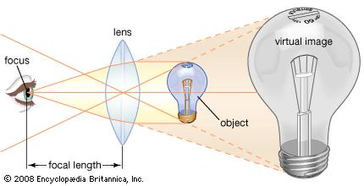
Magnification
Light source
Refraction
Light source
Notes:
Without lenses, the highest possible magnification is when the object is brought to the closest position at which a clear virtual image is observed. For many people, this image distance is about 25 cm (10 inches). FOCAL LENGTH.
The use of the magnifying lens between the observer and the object enables the formation of a magnified image known as the “virtual image” that can be viewed in comfort. To obtain the best possible image, the magnifier should be placed directly in front of the eye. The object of interest is then brought toward the eye until a clear image of the object is seen.

Slide 18
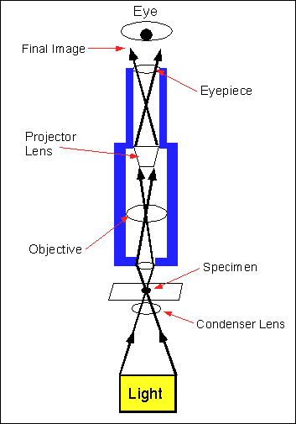
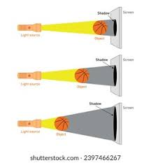
The compound microscope
Compound microscope = 2 or more lenses
1. Condenser lens to focus light onto sample
2. Objective lens collects light from
image & focuses it to form a magnified
image within the microscope barrel
3. Eyepiece allows an image to be viewed as if there were a projection in the pane of the section
Notes:
Modern microscopes magnify both in the objective and the ocular and thus are called “compound microscopes” - Simple microscopes have only a single lens

Slide 19
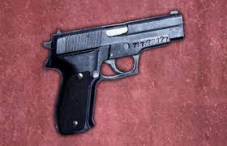
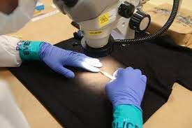
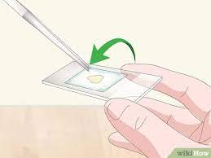
Determining magnification
The level of magnification determines the type of microscope needed:
Low Power Microscopes (LPM) magnifies an object x4-40
High Power Microscopes (HPM) magnifies an object x40-400
Low Power Microscopy (LPM)
Locate potential evidence:
Blood, fibres, paint, glass
High Power Microscopy (HPM)
Identify evidence with more certainty
Sperm, fibres, glass, paint
Mounted on a slide is vital

Slide 20
Calculating magnification
Reporting & presenting a magnified image
needs to state the magnification factor.
Total magnification calculated by multiplying
eyepiece lens (typically x10) with
objective lens magnification e.g., x10
Example
10x eyepiece lens x 10x objective lens
= 100x magnification

Slide 21
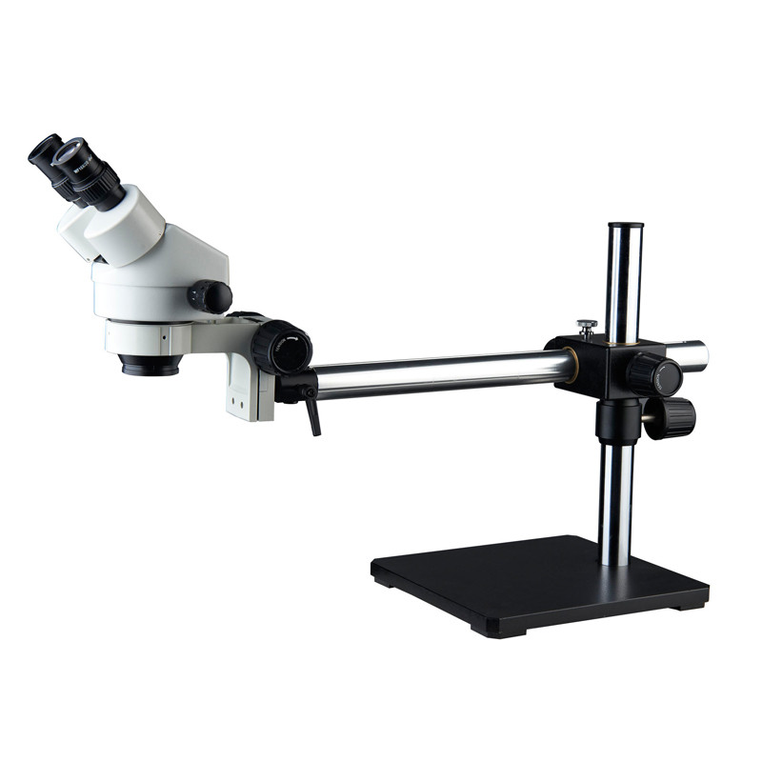
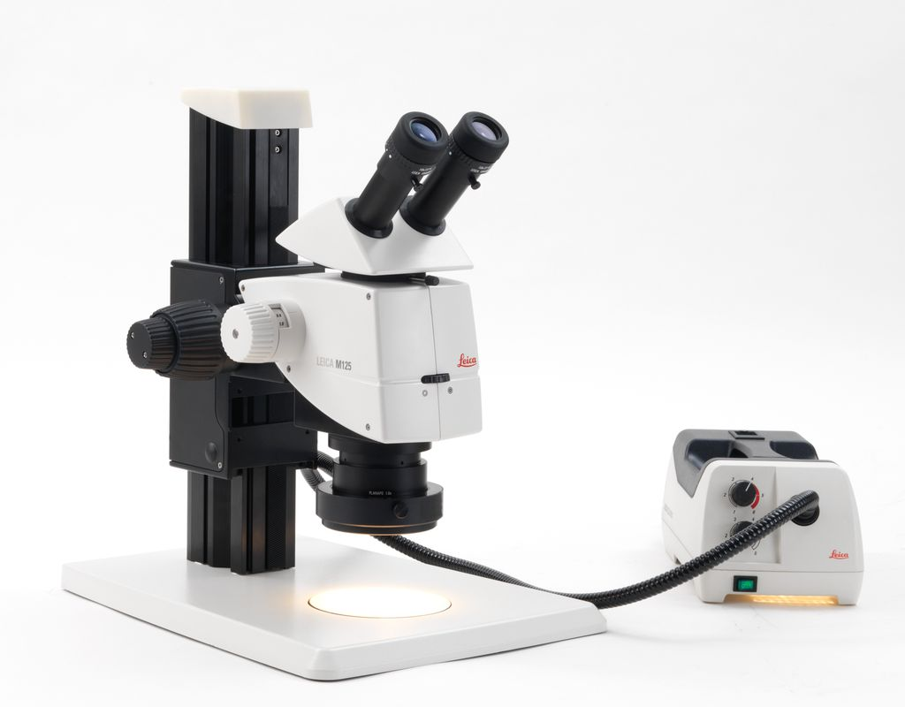
Anatomy of a Low Power Microscope
1.Condenser
Coarse/fine focus
On benches in ELA506
3. Eyepiece
3D items
3. Eyepiece
Light Source
Working Distance
Working Distance
2. Objective (hidden) for magnification
The only difference between these microscopes is the stand on (to allow greater flexibility)

Slide 22
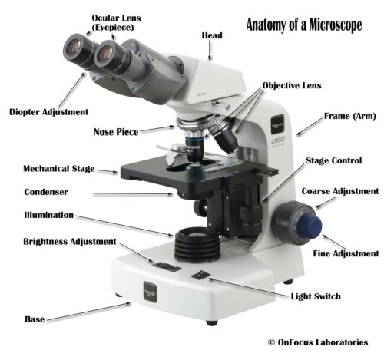
Anatomy of a High Power Microscope
3.
2.
1.

Slide 23
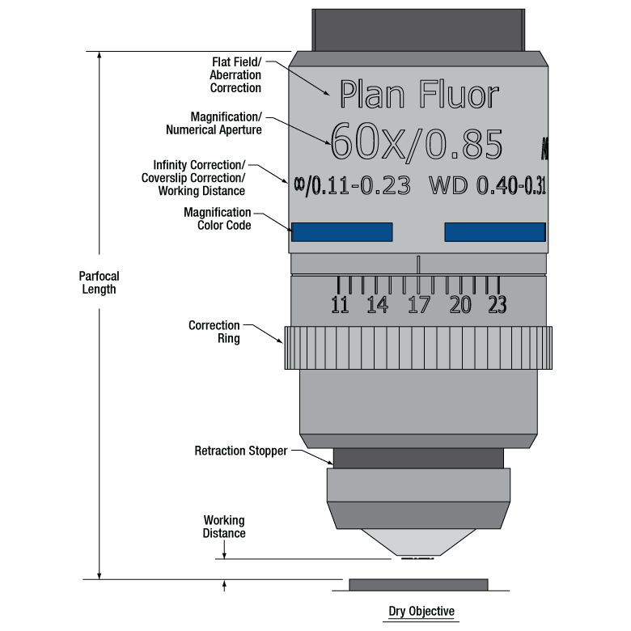
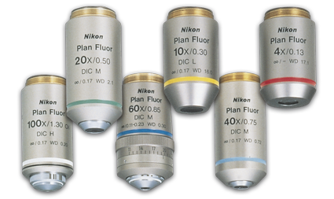
HPM Objective lenses
Needed for calculating the magnification

Slide 24
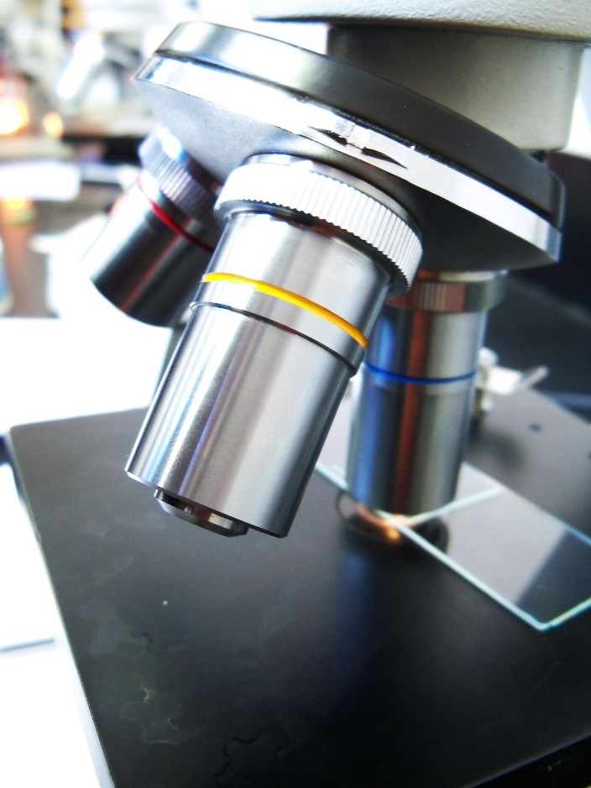

HPM Objective lenses
Focuses light rays at a specific point – the FOCAL POINT
Distance between centre of the lens & the FOCAL POINT is called the FOCAL LENGTH
Lens strength is related to FOCAL LENGTH
Short focal length = Higher magnification
Lens
Focal
point
Light source
Focal length
Object

Slide 25
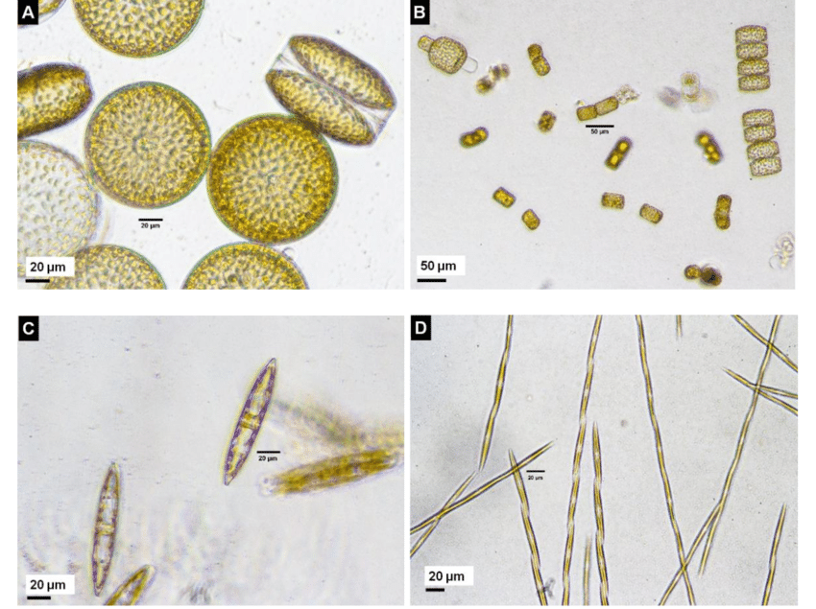
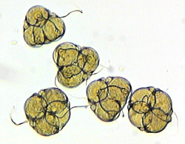
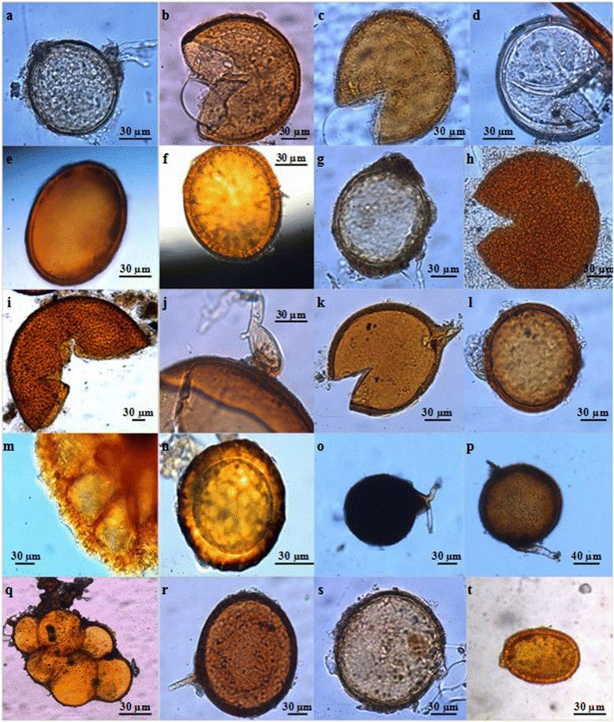
Forensic Ecology & Microscopy
Bayu et al., (2020)
Why might these be helpful in casework?

Slide 26

2024-2025 Forensic Science research project Can diatom communities be a tool to determine water conditions in drowning cases?
Why?
Diatoms are key primary producers within freshwater food webs
Diatoms are key biomarkers for changes in water conditions
In Forensic Science, diatoms are used to determine drowning
Can they be useful to infer location of drowning?

Slide 27


River Don diatom sampling
Downstream Nature Reserve
(D)
Mildene Farm
(C)
Outflow
(B)
Upstream
(A)

Slide 28
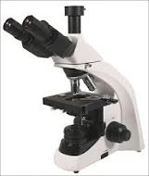
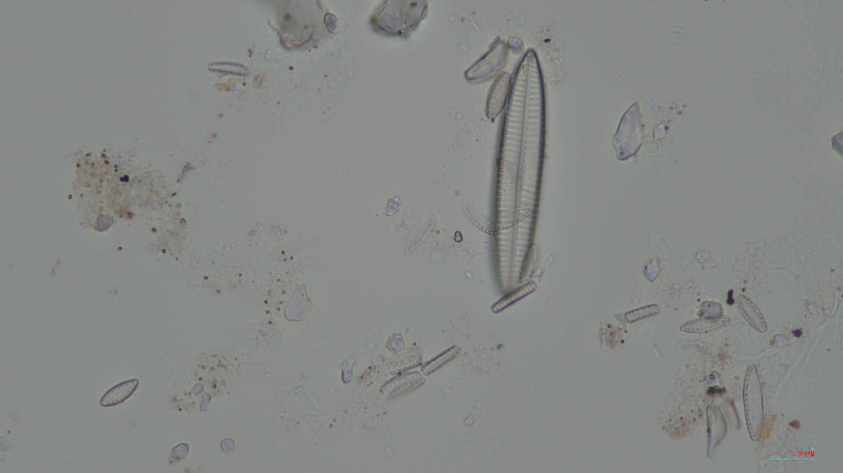
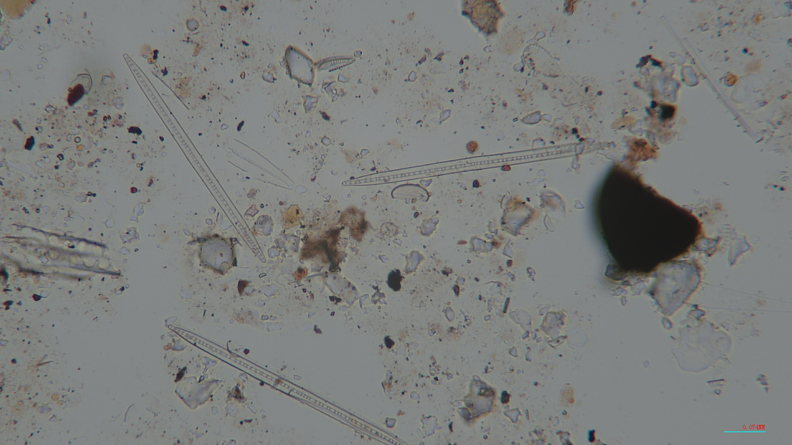
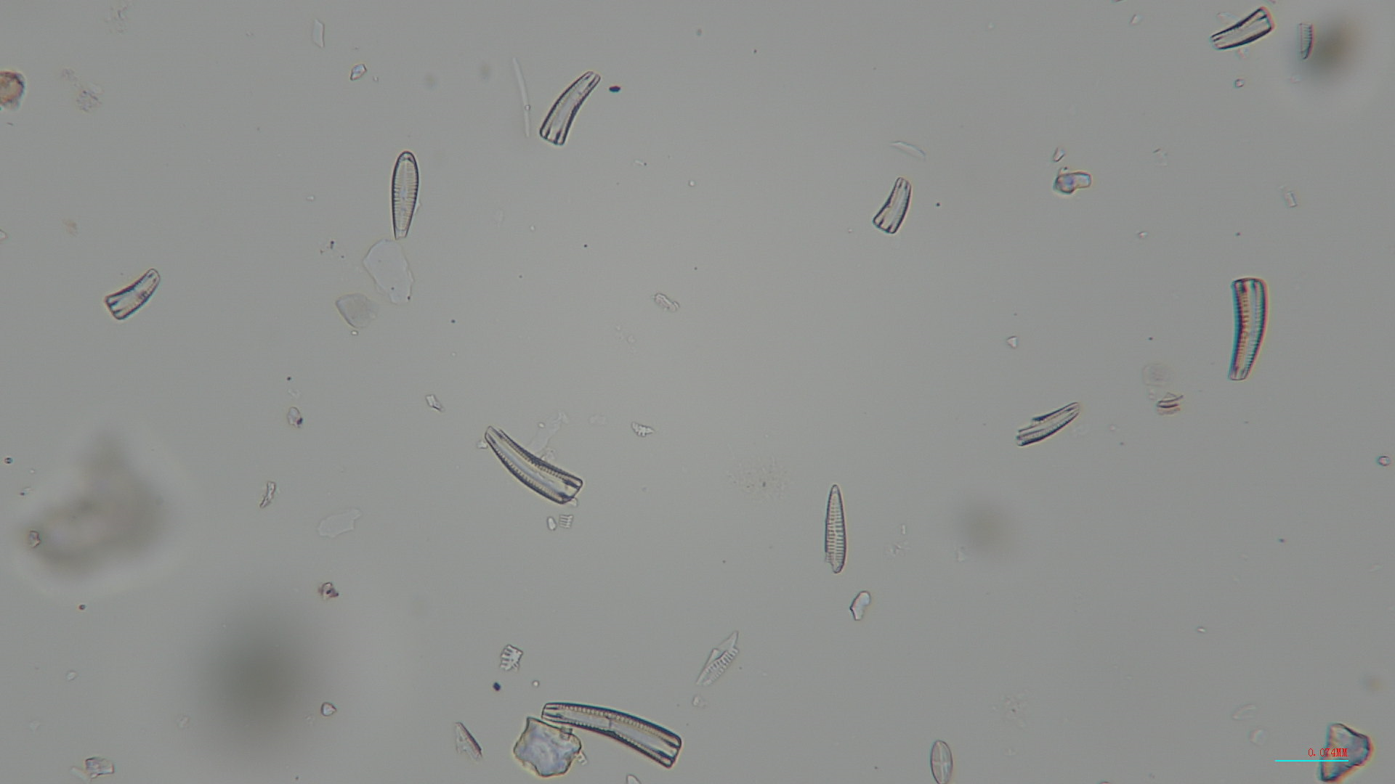
Parameters measured
Rock scrapes
Diatom morphotype ID
Diatom morphotype abundance, richness profiles
Water - pH, flow rate, temperature and DO
x100 magnification

Slide 29
Break time

Slide 30
Gaining extra information using different types of microscopy

Slide 31
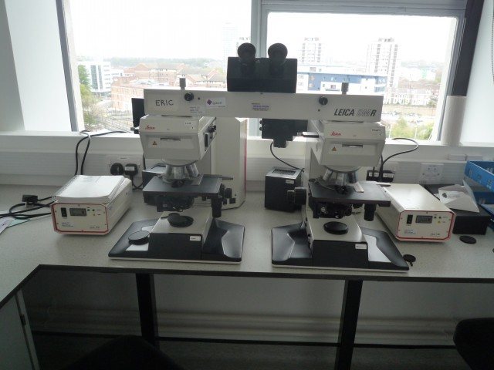
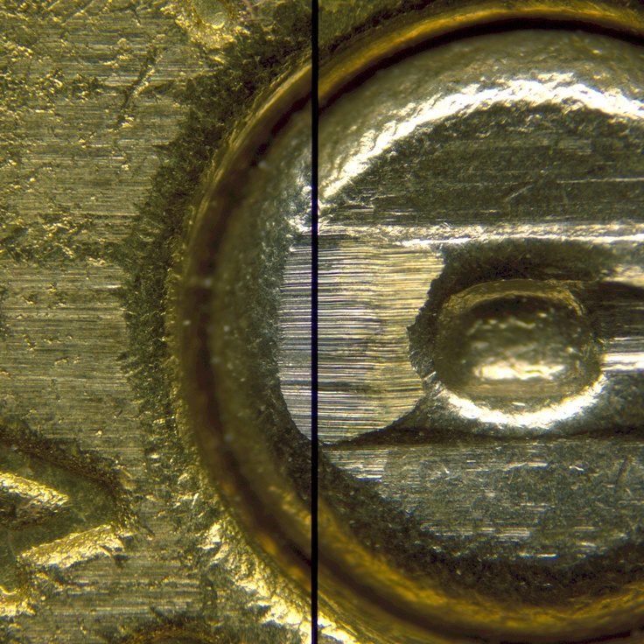


Comparison Microscopy
Two HPMs connected by an optical bridge
Allows two samples to viewed side by side for comparison purposes
Why might this be important in casework?
A
B
A
B

Slide 32
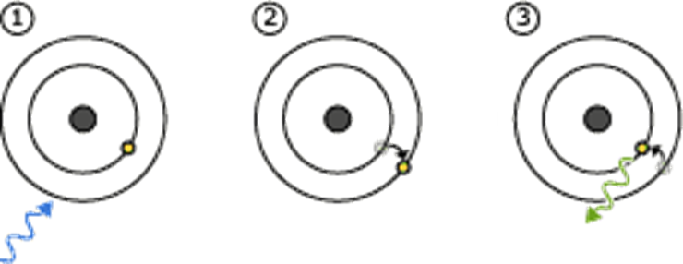
Comparison Microscopy
Samples primarily viewed in bright field (white light)
Some comparison microscopes can assess fluorescent & optical properties of a sample
Fluorescent Microscopy
Polarising Light Microscopy (PLM)
Fluorescence

Slide 33
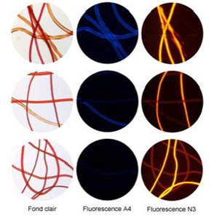
Fluorescence Microscopy
Different excitation filters can be used as materials may fluoresce at different wavelengths
Typically use UV excitation (330-380nm) across blue, green & red spectral regions
Blue excitation across green, yellow, red and near infra-red (450-490nm)
White light
UV filter
Blue filter

Slide 34
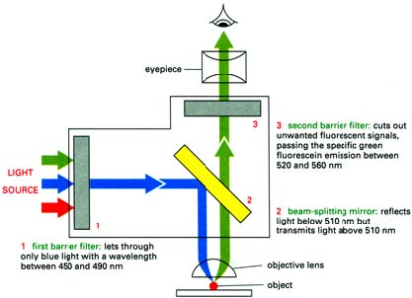
Fluorescence Microscopy
Uses a high intensity light
to illuminate a sample
Light excites fluorescence
species in the sample, which
emits light of a longer
wavelength
The image produced is
based on the emission
wavelength of the fluorescent
species rather than
from the light originally used
to illuminate, & excite, the sample
A dichroic mirror
is used to separate
excitation & emission
light paths
Light source
typically a
mercury-vapour
lamp
Forensic
application:
Forensic paint &
fibre analysis

Slide 35
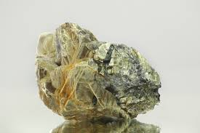
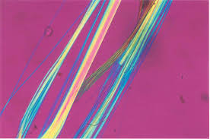
Polarised Light Microscopy (PLM)
Microscopy used to exploit optical properties of a material
Forensic Application:
A semi-qualitative method for fibre & paint identification
Fibre analysis: PLM is can differentiate between fibres type
e.g., polyester vs. nylon
Used as a comparison feature in the analysis of paint & fibres

Slide 36
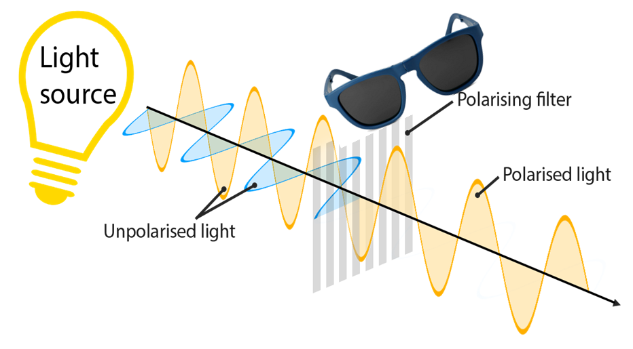
What is polarised light?
Natural light is unpolarised i.e. it’s light waves will be travelling in more than one plane (direction)
By applying a filter, the unpolarised light can become polarised (plane polarised light, PPL) such that its light waves will only travel in one plane (one geometrical oscillation
Different materials have properties that produce characteristic results
with PML to aid identification

Slide 37
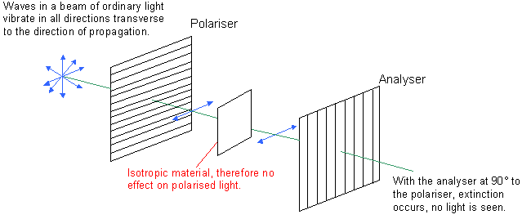
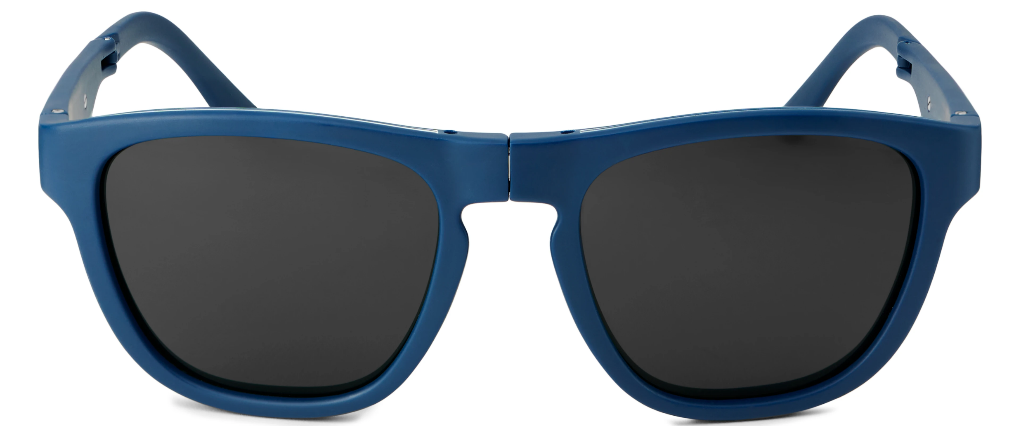
Effect of isotropic materials on PPL
Waves in a beam of ordinary light vibrate in all directions transverse to the direction of propagation
Analyser
Sample
No light coming out
With the analyser at 90º to the polariser, extinction occurs
2x filters at opposing orientations = Crossed polars

Slide 38
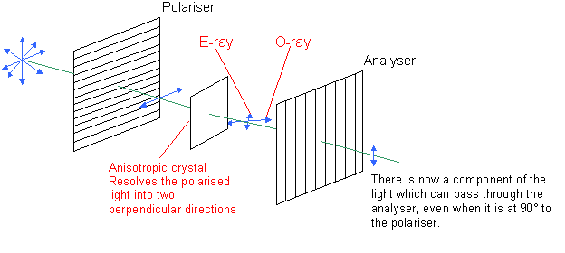
Effect of anisotropic materials on PPL
Analyser
Sample
Light coming out
There is now a component of the light which can pass through the analyser, even when it is at 90º to the polariser
2x filters at opposing orientations = Crossed polars

Slide 39
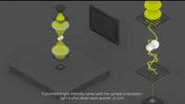
Video
Polarised Light Microscopy (PLM)

Slide 40

PLM with isotropic & anisotropic materials
Isotropic material
Anisotropic material
Has one refractive index (RI)
e.g. glass, metals, variety of gases, liquids, cubic crystals
No restriction on the vibration direction of light passing through them
Has > one refractive index (RI)
e.g. fibres, some paint, crystals, minerals
Referred to as Birefringent
Optical properties vary with light orientation
‘Beamsplitters’, dividing light rays into two orthogonal components

Slide 41

Fibre differentiation using PLM
RI 2 (R2)
RI 2 (R2)
RI 1 (R1)
RI 1 (R1)
Nylon
Red fibre
Polyester
Red fibre
R1 – R2 = Birefringence
Nylon fibre R1 – R2 ≠ Polyester fibre R1 – R2

Slide 42

Polarised Light Microscopy (PLM) in action
Stop after 4 mins

Slide 43
Birefringence is viewed as interference colours
Exhibited by anisotropic material under cross polarised light
Interference colour produced by interference between 2 rays as plane polarised light passes through the anisotropic material
Interference is a function of the birefringence of the material (having multiple RI’s)
Birefringence (Δ_{n}) is determined by subtracting the refractive index (n) taken across the width(┴) from that along the length(║).
Δ_{n} (birefringence) = n║ - n┴
NOTE - Thickness of sample is also influence colours seen

Slide 44

Birefingence Michael-Levy Chart

Slide 45




Polarised Light Microscopy (PLM)
Interference colours are observed

Slide 46
Lecture summary
Identify & understand the components of a light microscope
Understand the principles of optics that apply to light microscopes
Have an appreciation of how microscopy is used for forensic analysis
Know about comparison & fluorescence microscopy
Determine whether a material is isotropic or anistropic using polarising light microscopy (PLM)
Enjoy your Microscopy labs!

